Slide 1
Lecture-1
Chapter-18
Temperature, Heat and The First Law of Thermodynamics
Thermodynamics: This is the study and application of the thermal energy.
Thermal Energy: This is the energy that comes from heat which is generated by the movement of the particles. This is often called the internal energy.
Temperature: Temperature is the measure of the average heat or thermal energy of the particles. One of the central concepts of thermodynamics is temperature.
Unit: SI unit of temperature is K (Kelvin)

Slide 2
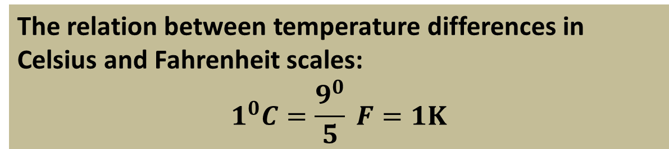

It is measured with a thermometer, which contains a working substance with a measurable property, such as length or pressure, that changes in a regular way as the substance becomes hotter or colder.
Three popular temperature scales are Kelvin scale, Celsius scale and Fahrenheit scale.
The relation between the 3 scales are:
$$\frac{C}{5}=\frac{F−32}{9}=\frac{K−273.15}{5}$$
The relation between temperature differences in Celsius and Fahrenheit scales:
$$1^{0}C=\frac{9^{0}}{5} F=1K$$

Slide 3
Absolute Zero: The lower limit of temperature is called the absolute zero which is 0K.
Triple Point Cell
Triple Point of Water: A temperature at which the solid ice, liquid water and water vapor coexist in thermal equilibrium is called the triple point of water.
Its value is 273.16K

Slide 4
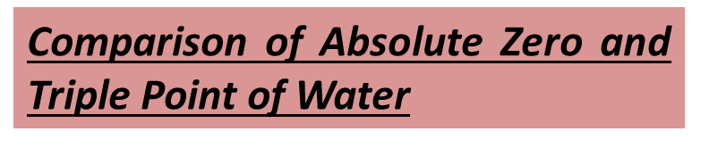

Slide 5

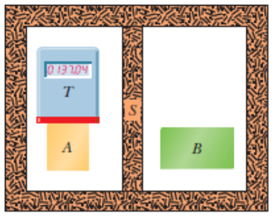
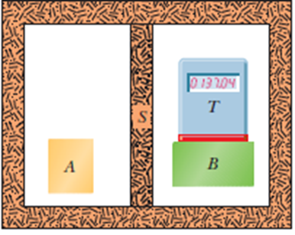
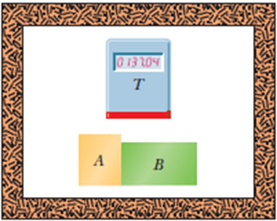
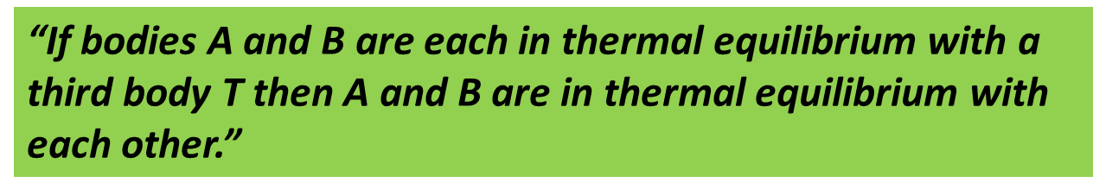
Suppose that, as in following Fig (a) , we put a thermoscope (which we shall call body T) into intimate contact with another body (body A).The entire system is confined within a thick-walled insulating box.

Slide 6
Absorption of Heats
Heat: Heat is the energy that is transferred between a system and its environment due to the temperature difference between them.
Heat is positive when energy is transferred to a system and negative transferred from the system.
Units of Heat:
1. Joule (J)
2. Calorie (cal)
3. British Thermal Unit (BTU)
The relations among the various heat units are:
1 cal=3.968×10⁻³ Btu = 4.1868 J.

Slide 7
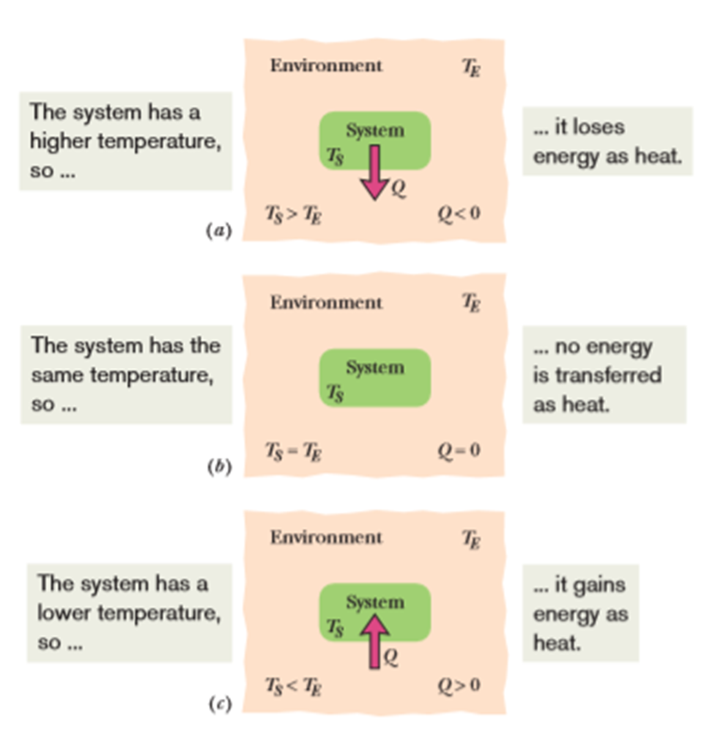

Slide 8
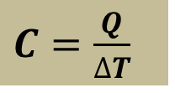
Absorption of Heat by Solid and Liquid
Heat Capacity: The amount of heat that is absorbed or lost by an object to change unit temperature is called the heat capacity of that object.
$C=\frac{Q}{∆T}$
Unit: cal/⁰C or cal/K or J/K.

Slide 9
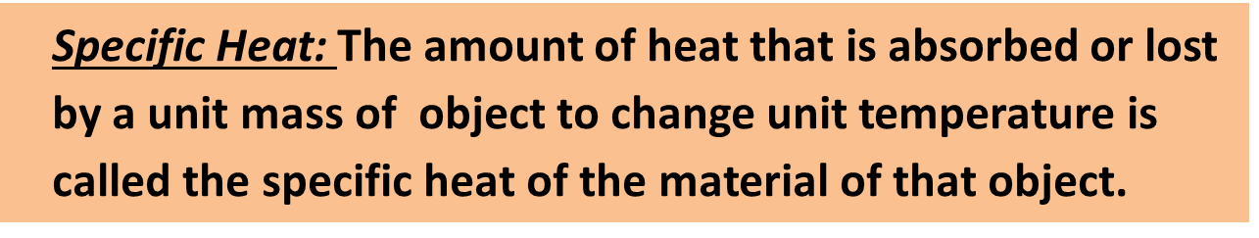
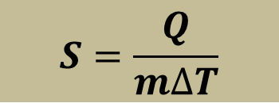


Molar Specific Heat: The amount of heat that is absorbed or lost by one mole of object to change unit temperature is called the molar specific heat of the material of that object.
$S=\frac{Q}{n∆T}$
Unit: J/mol.K

Slide 10
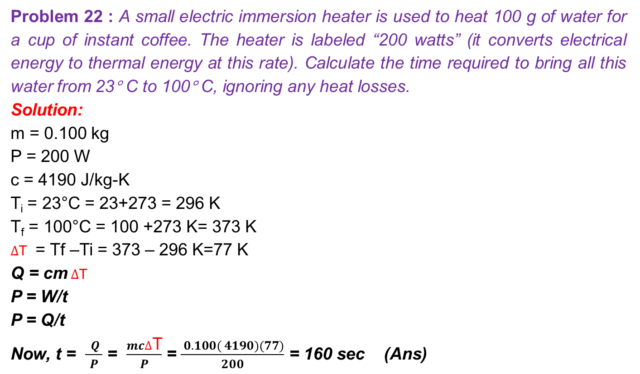
Problem 22 : A small electric immersion heater is used to heat 100 g of water for a cup of instant coffee. The heater is labeled “200 watts” (it converts electrical energy to thermal energy at this rate). Calculate the time required to bring all this water from 23° C to 100° C, ignoring any heat losses.
Solution:
m = 0.100 kg
P = 200 W
c = 4190 J/kg-K
T_{i} = 23°C = 23+273 = 296 K
T_{f} = 100°C = 100 +273 K= 373 K
$∆$T = Tf –Ti = 373 – 296 K=77 K
Q = cm $∆$T
P = W/t
P = Q/t
Now, t = $\frac{ Q }{ P }$ = $\frac{mc∆\text{T}}{ P }$ = $\frac{ 0.100( 4190)(77)}{200}$ = 160 sec (Ans)

Slide 11
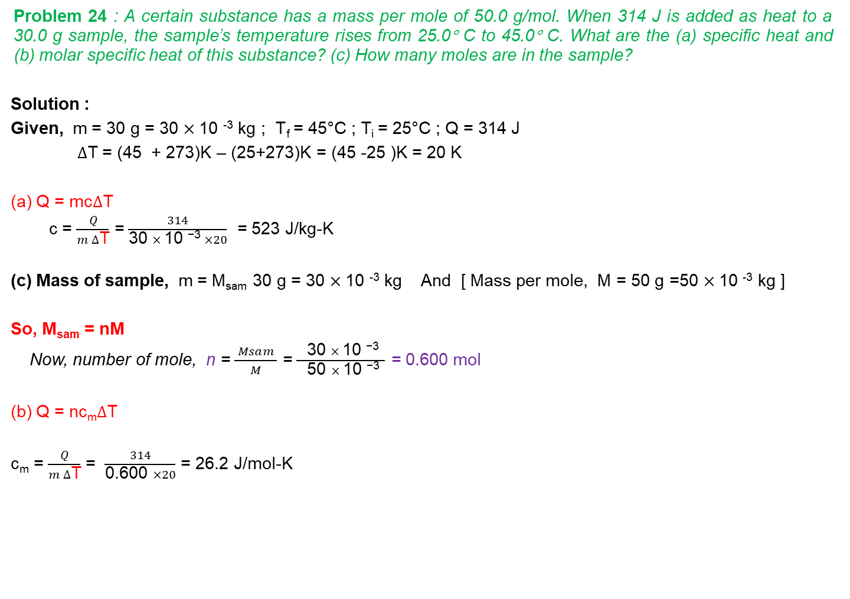
Problem 24 : A certain substance has a mass per mole of 50.0 g/mol. When 314 J is added as heat to a 30.0 g sample, the sample’s temperature rises from 25.0° C to 45.0° C. What are the (a) specific heat and (b) molar specific heat of this substance? (c) How many moles are in the sample?
Solution :
Given, m = 30 g = 30 $×$10 ⁻³ kg ; T_{f} = 45°C ; T_{i} = 25°C ; Q = 314 J
$∆$T = (45 + 273)K – (25+273)K = (45 -25 )K = 20 K
(a) Q = mc$∆$T
c = $\frac{ Q }{m ∆\text{T}}$ = $\frac{ 314 }{\text{30 }× \text{10 }\text{−3} ×20}$ = 523 J/kg-K
(c) Mass of sample, m = M_{sam} 30 g = 30 $×$10 ⁻³ kg And [ Mass per mole, M = 50 g =50 $×$10 ⁻³ kg ]
So, M_{sam} = nM
Now, number of mole, n = $\frac{ Msam }{M}$ = $\frac{ \text{30 }× \text{10 }\text{−3 }}{\text{ 5}\text{0 }× \text{10 }\text{−3} }$ = 0.600 mol
(b) Q = nc_{m}$∆$T
c_{m} = $\frac{ Q }{m ∆\text{T}}$ = $\frac{ 314 }{\text{0.600 }×20}$ = 26.2 J/mol-K

Slide 12
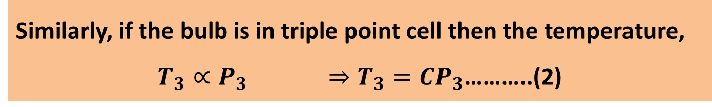



Constant Volume Gas Thermometer:
This is a standard thermometer which is consists of a gas-filled bulb at constant volume.
The temperature of an object,
$T∝P ⇒T=CP$ …………(1)
Similarly, if the bulb is in triple point cell then the temperature,
$T_{3}∝P_{3} ⇒T_{3}=CP_{3}$………..(2)
$$\left(1\right)÷\left(2\right)⇒$$
$$\frac{T}{T_{3}}=\frac{P}{P_{3}} ⇒T=T_{3}\frac{P}{P_{3}}$$
$$T=273.16 \frac{P}{P_{3}}$$

